Slide 1
Survey on Virtual Machine Allocation in Cloud Infrastructure - Progress Report
Ashwini Ukarde
Neha Bhoi
Saishree Jayakumar

Slide 2
Table of content
Introduction
Interior Search Algorithms
K means
Reordering Grouping Genetic Algorithm
Future Work

Slide 3
Introduction
Virtual Machine Allocation
Virtual machine allocation problem is one of the challenges in cloud computing environments.
In this environment, each virtual machine is mapped onto the physical host in accordance with the available resource on the host machine
we have taken some algorithms for consideration under different aspects specializing in energy, time efficiency and resource allocation

Slide 4
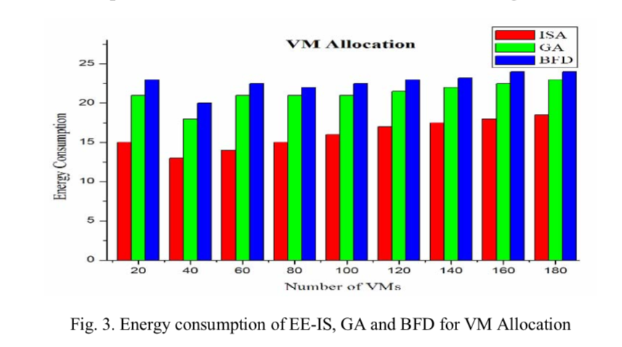
Interior Search Algorithm (ISA)
Importance of Energy Efficiency
Working of Interior Search Algorithm (ISA)
Performance of ISA compared with other traditional algorithms
Challenges
Saves 30% of energy compared with BFD and GA

Slide 5
K-means Algorithm
Time efficient algorithm
K-means algorithm uses clustering technique.
Clustering - Divide the large dataset into small groups having similar characteristics
Number of clusters determined dynamically according to number of data centers to number of hosts
Depending upon the number of hosts, number of K clusters in a datacenter are determined
Result: -
Idle time less compared to traditional FIFO
Better CPU Utilization

Slide 6
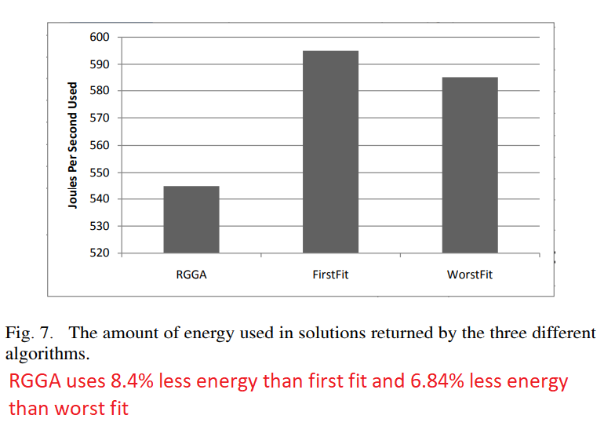
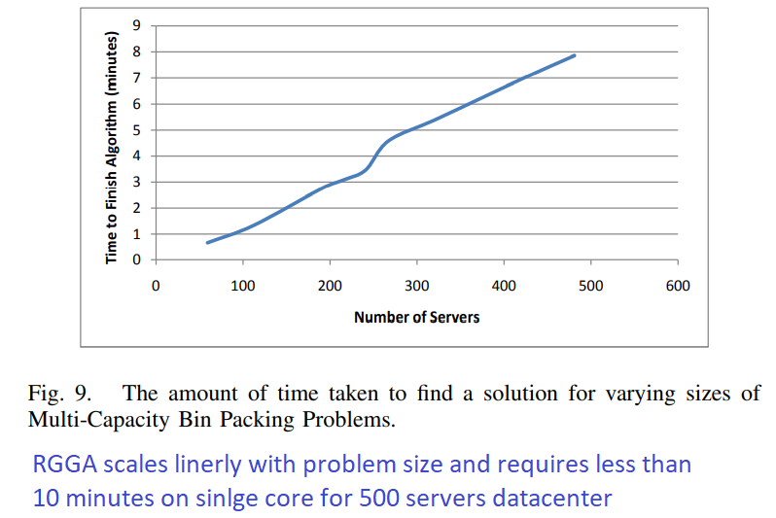
Reordering Grouping Genetic Algorithm
Genetic Algorithm
Needs Deterministic Load
Energy Efficient
Requires less time to solve the problem
Based on bin packing problem

Slide 7
Future Work
- Deep dive to understand the exact working of the algorithm. Read more papers.
Analysis of remaining 3 algorithms.
Mixed Integer Program
A Novel Family Genetic Approach
Hybrid Genetic Algorithm

